Slide 1




Unified E-Commerce ETL Ecosystem
Project Link 🔗

Slide 2



Problem Statement
Modern e-commerce platforms generate vast amounts of fragmented data across multiple relational entities (Customers, Products, Orders, Transactions). The core challenges addressed by this project include:
● Data Silos: Difficulty in consolidating high-volume transactional data with low-volume reference data for a holistic view.
● Data Quality: Raw data often contains inconsistencies that prevent accurate business intelligence and machine learning.
● Latency in Insights: The lack of a structured pipeline (Medallion Architecture) makes it difficult to serve real-time analytics and predictive modeling simultaneously.
● Scalability: Existing systems often struggle to handle growing datasets while maintaining an Operational Data Store (ODS).
Data🔗

Slide 3

Proposed Solution
The solution implements a scalable Medallion Architecture using a modern data stack to transform raw e-commerce data into actionable insights.
● Multi-Source Ingestion: Handling both high-volume and low-volume data streams.
● Three-Tier Processing:
○ Bronze: Raw data ingestion.
○ Silver: Data cleaning, deduplication, and relational integrity enforcement.
○ Gold: Aggregated business-level tables ready for consumption.
● Dual-Purpose Output: Simultaneous support for Data Visualization (BI) and ML Serving (Predictive Analytics).
● AI Integration: An integrated AI Agent/Dashboard to facilitate natural language querying and automated reporting.

Slide 4
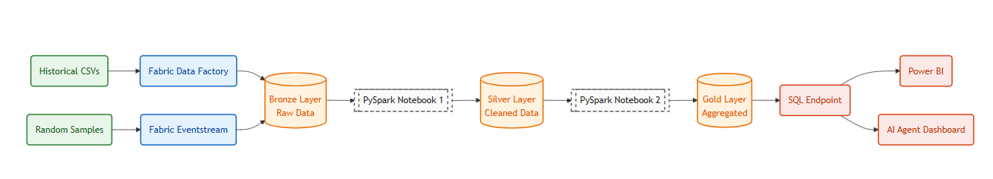
Project Architecture (System Map)
Raw synthetic e-commerce data is ingested into a three-tiered lakehouse storage system (Bronze, Silver, Gold) and served via dashboards and an AI-driven web app.
🔗

Slide 5
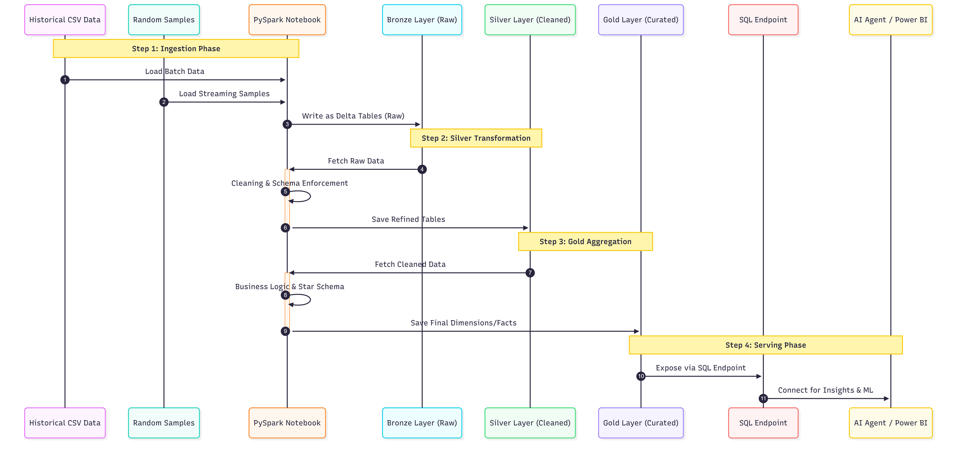
Sequential Diagram
This diagram represents the execution flow of a single data batch through the ecosystem:
🔗

Slide 6
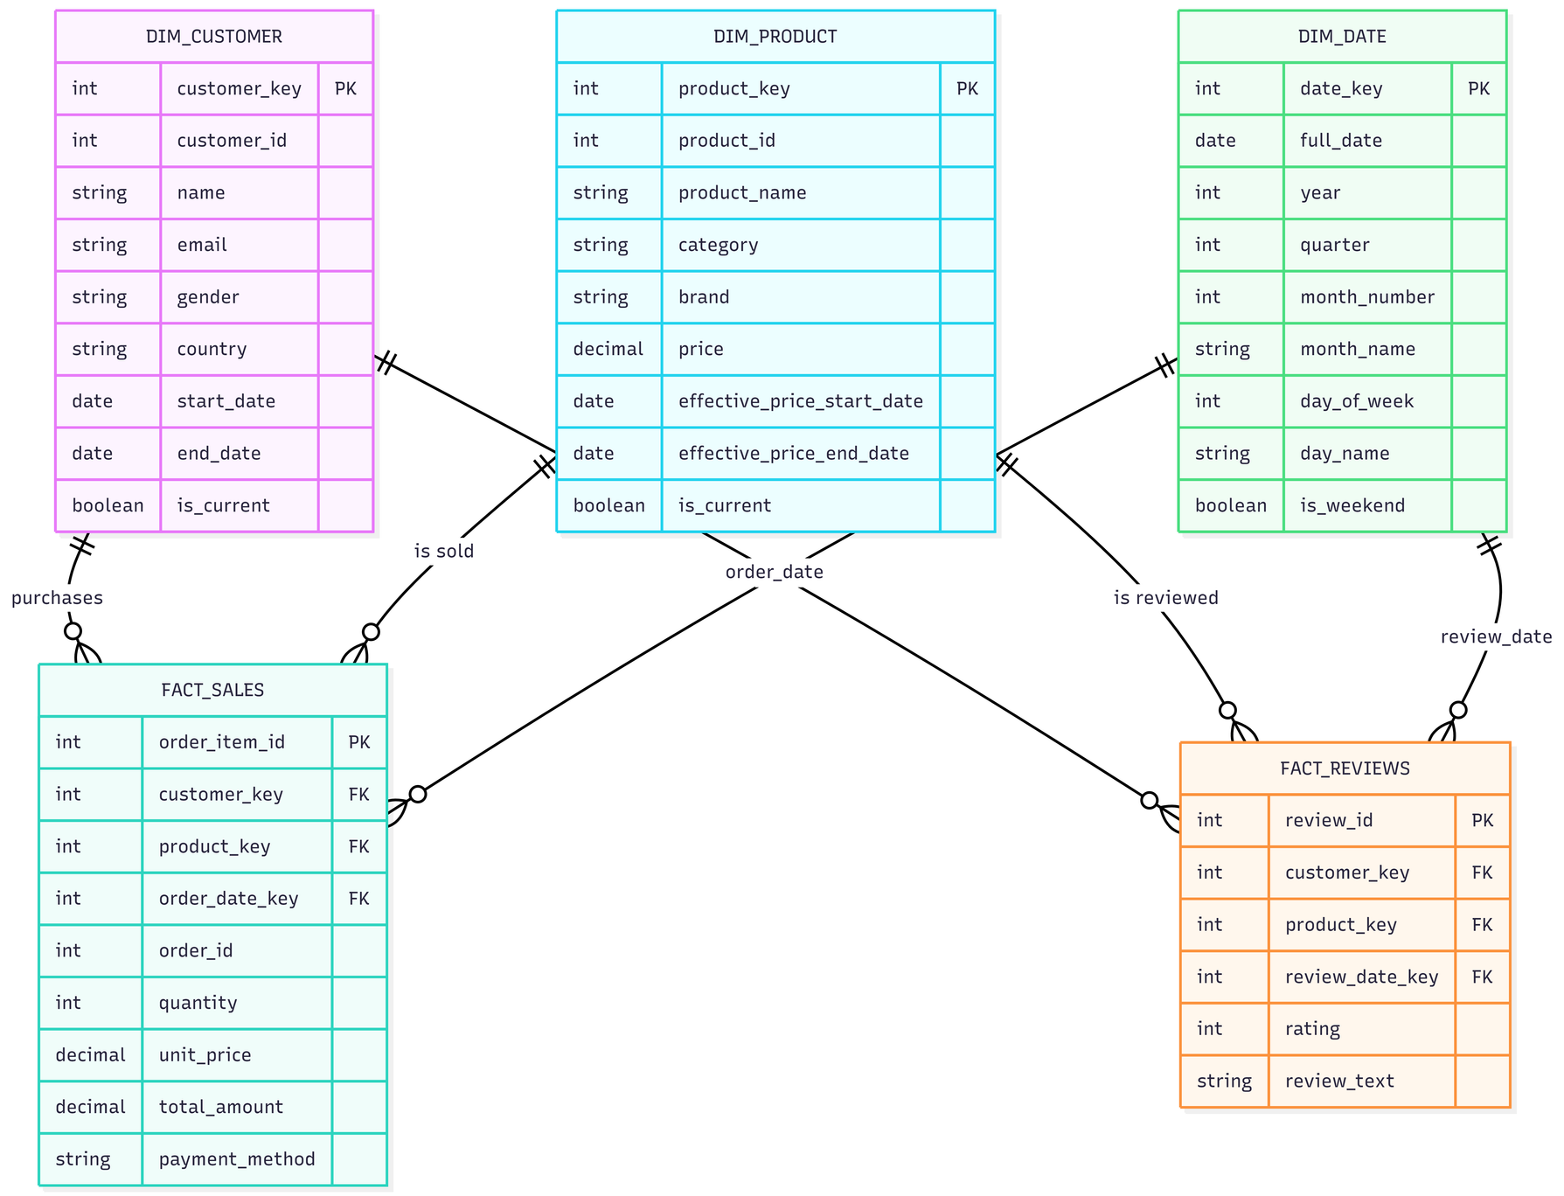
Data Modeling
The data model transitions from a highly normalized relational structure in the Silver layer to a denormalized Star Schema in the Gold layer.
Entities:
Fact Tables: Fact_Sales, Fact_Transactions.
Dimension Tables: Dim_Customers, Dim_Products, Dim_Date, Dim_Location.
Relationships:
Fact_Sales links to Dim_Products via product_id.
Fact_Sales links to Dim_Customers via customer_id.
Dim_Products includes category hierarchies for deep-dive analysis.
🔗

Slide 7
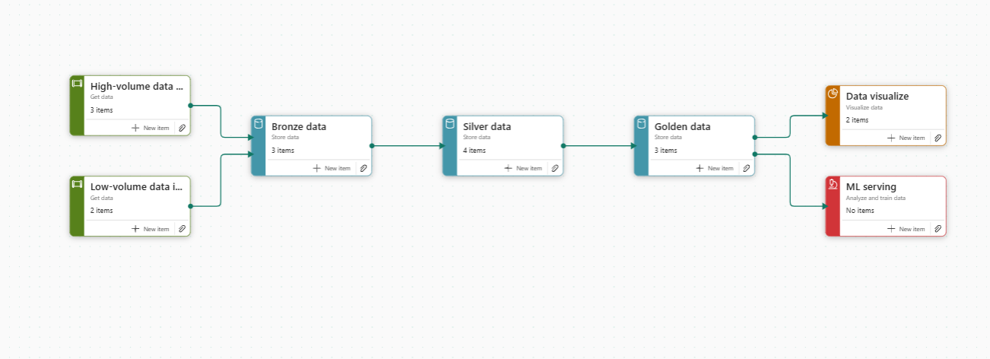
Fabric Pipeline Governance
A live look at our end-to-end Medallion orchestration, team ownership, and data stream automation inside Microsoft Fabric.

Slide 8
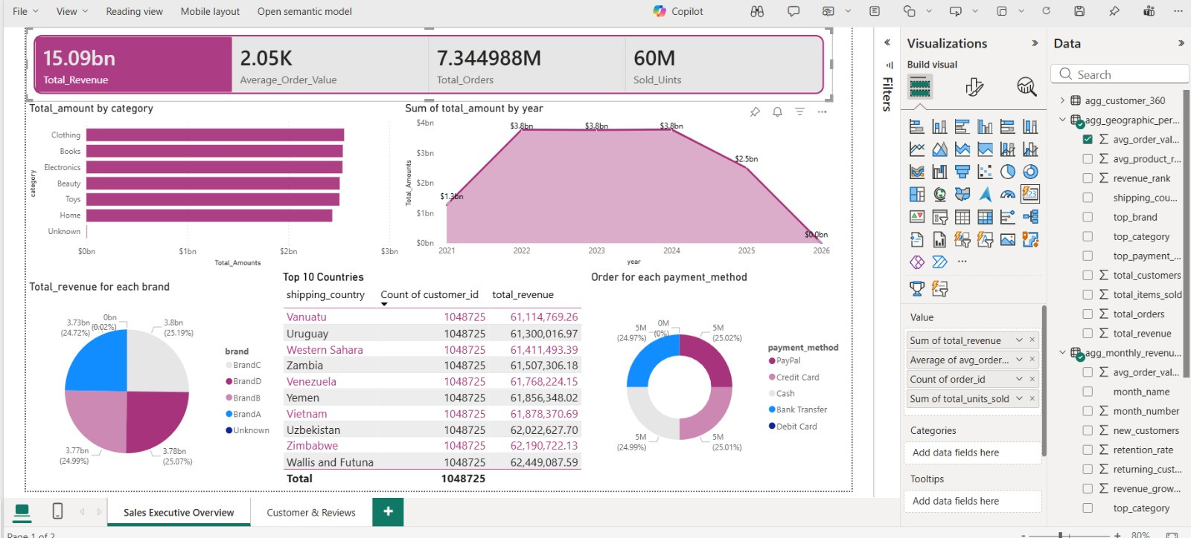
BI Analytics
Power BI dashboard visualizing $15.09bn in total revenue alongside core metrics like average order value, total orders, and payment breakdown.

Slide 9
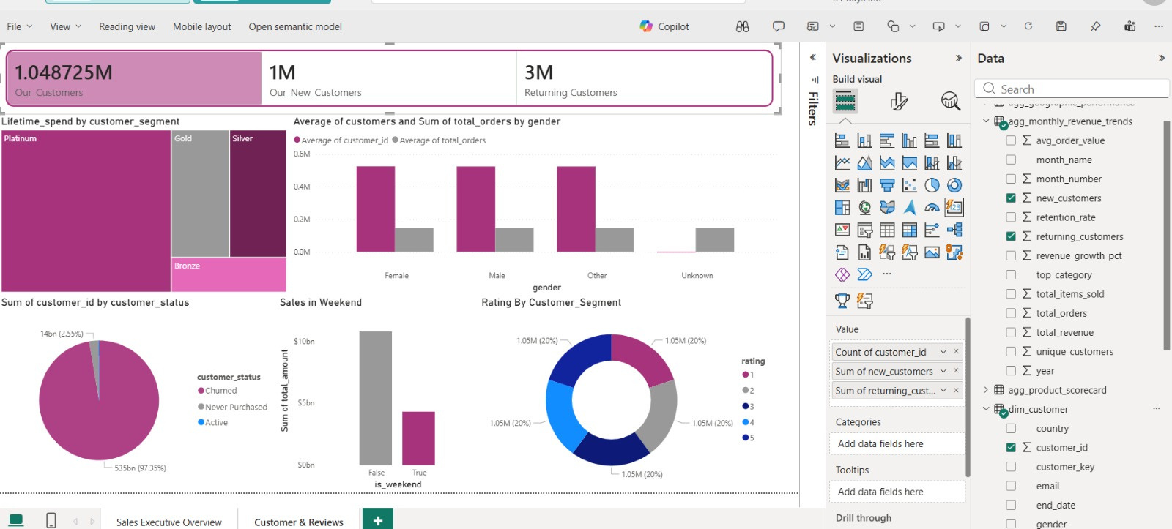
BI Analytics
A consumer intelligence Power BI dashboard profiling 1.04M total customers alongside core metrics like segment lifetime spend, retention status, and review ratings.

Slide 10
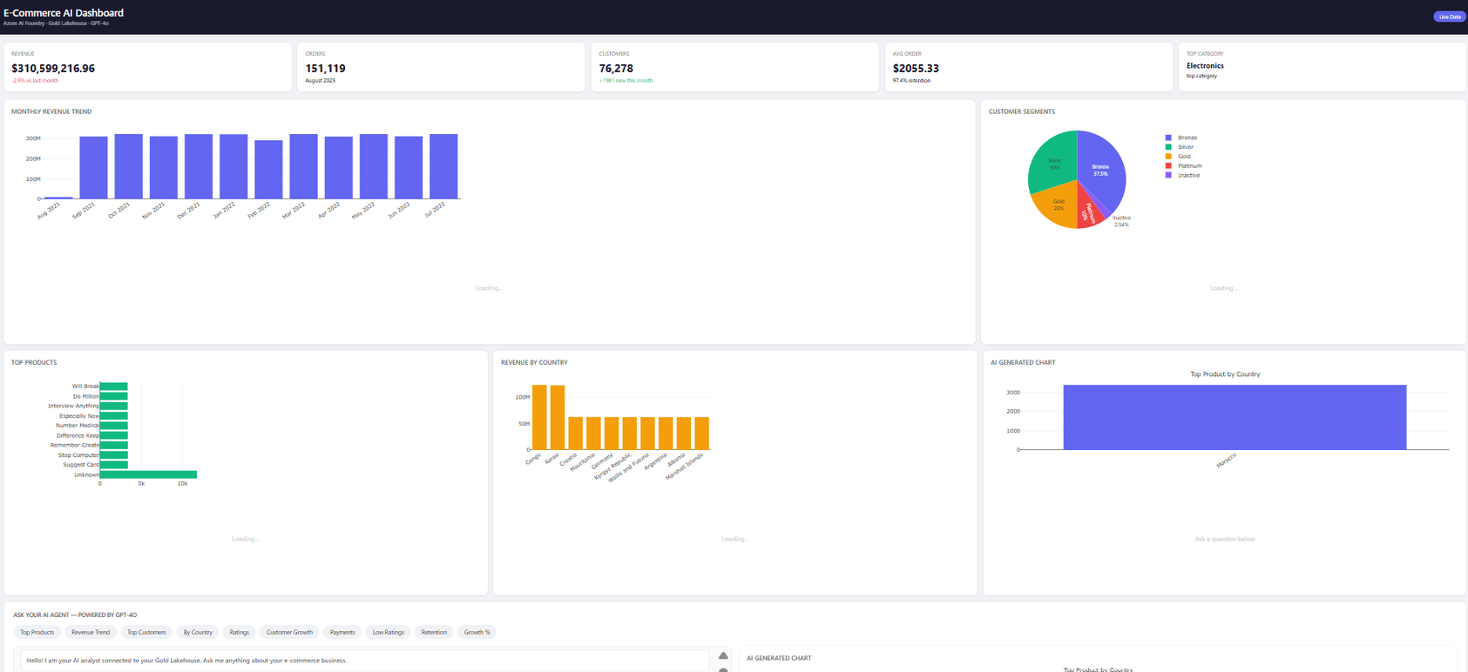
AI Agent Integration
The Azure-hosted AI Agent translates natural language to SQL and delivers predictive insights by querying the lakehouse's refined data layers.
You can try it🔗

Slide 11


Our Team
Passant Ali Abu-Elkheir
Mariam Salah Abd Elsabour
Claudio Akram Ayoub
Kareem Hussein Monir
Mohamed Elsayed Mansour
Maged Abdelrazik Ahmed

Slide 12

Thank You!
Github🔗

